Slide 1
Online student refunds
WSU Experience
Nyaradzo Majaji
DD Student Fees and Financial Aid

Slide 2
Presentation Outline
The manual process (the before)
The online refund process (the current process)
Student refund process overview
Setups for online refunds
High level demo (student perspective)
High level demo (back office)

Slide 3
The manual process (the before)
We have been using the online refund process since 2023 (for 2 years)
The manual process was inefficient:
one official could process only 10 forms per day
Refund forms were submitted to student fees or by email.
Refunds were processed twice a month and that after the close of the registration period. This became untenable due to oversubscription for FTEN spaces.
Student fees would verify the refund forms and if approved they would do a cheque requisition which was processed by creditors.
It was extremely difficult to handle and track queries for both students and student fees.
Creditors would process the refund through generating a CT report from ITS.

Slide 4
The online refund process (the current process)
Students apply for a refund on-line on in-enabler,
They capture banking details and uploading supporting documents,
System does not allow a refund application if there is no credit balance,
Student fees review the application and supporting documents
Student fees draw a report which is then processed by creditors for payment. Payments are done on a weekly basis.
Up to 50 forms are processed per day.
Students can track the status of their application.
Different teams follow the same procedure

Slide 5
The benefits of the online refund process
We can process a high volume of refunds (up to 300 per week), during the registration period
System controls and prevention of errors and fraud
It is quicker and more convenient for students to submit applications
Applications don’t get lost or misplaced
Improved customer service – student fees is able to provide feedback to students online
We are able to generate various reports (applications submitted and applications at different stages of the process) and make management decisions
Students are able to track their applications online
Self capturing by users reduces errors and makes the process faster

Slide 6
PROCESS OVERVIEW
Student fees (Back office)
If the ITS refund report is approved loads in the bank.
Generates payment report and report of amounts processed and to be released in the bank.
Student appliers for refund on ienabler only if have a credit balance
Capture banking details
Upload supporting documents
Review and approve applications.
Verify the amount to be refunded to each student
Approve the banking details
Process the refund
Generate report to be reviewed and approved and loaded on the bank by creditors.
Student
Ienabler system
Creditors

Slide 7
Setups for online refunds
Create business functions for refunds on STWEB
Refunds
Terms and conditions
Refund application
Refund upload supporting documents
Refund information
Maintain banking details
Banking details rules and regulations
Capture banking details
Upload supporting documents
The refunds option and the related business process are then activated on ienabler.

Slide 8
Setups for online refunds (Cont’d)
Routing and communication info
Set ups of where the applications are routed to and notifications (GROU / GCS)
We operate from 4 campuses
We have therefore set up our business processes so that refund applications are directed to different campuses

Slide 9
Demo – student perspective

Slide 10
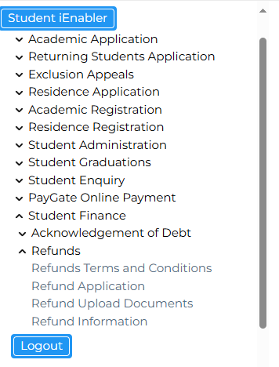
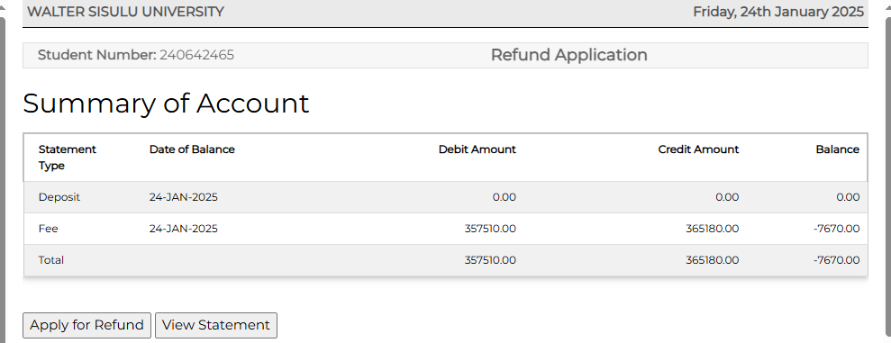
Student viewer - Ienabler
Landing page
Refund application page below

Slide 11
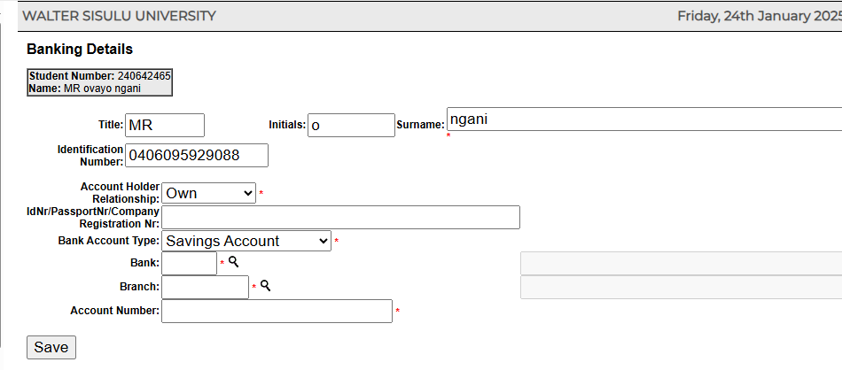
Processes and steps in an automated system- Front office Ienabler
Student capturing banking details
Students captures banking details

Slide 12
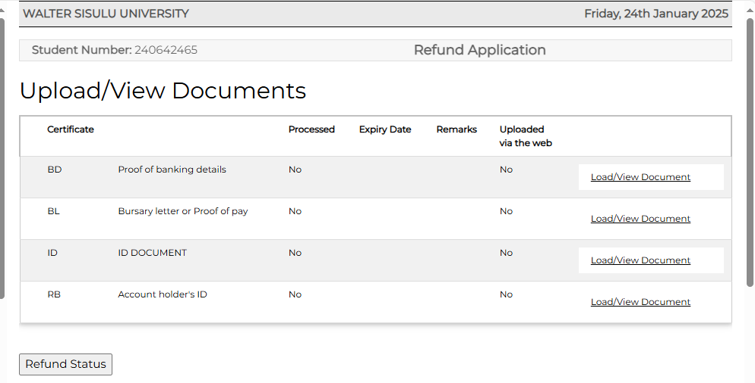
Student uploads supporting documents

Slide 13
Processes and steps in an automated system- Front office Ienabler
Student can check the status of the refund application

Slide 14
Demo – back office perspective

Slide 15
Refunds – back office
Student fees retrieve all student refund applications submitted (FCTO)
Student fees checks and verifies each application, including verifying submitted documents
They verify and approve banking details
They insert different status as they progress with each application including sending emails directly to students for queries or rejections
Last step is running a report of approved applications which is then submitted to creditors for payment.
Creditors then run the payment file

Slide 16
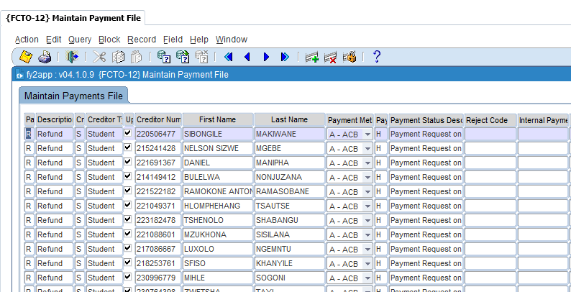
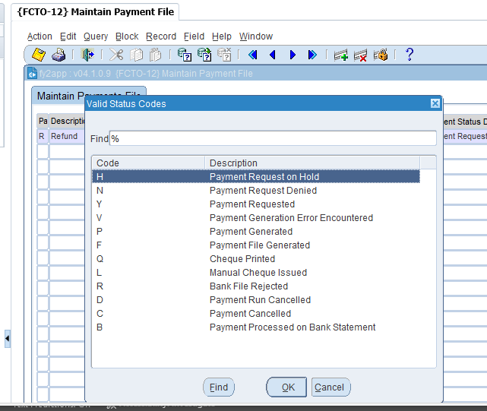
Maintain payment file and insert statuses

Slide 17
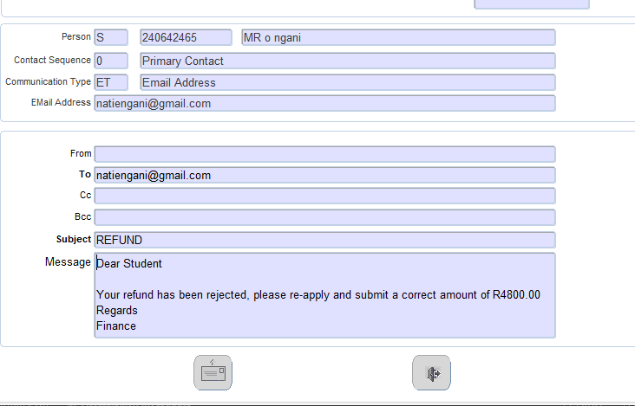
Communication with students
Student re-apply when existing application is rejected. The system doesn’t allow a student to submit a new application if there’s a pending one.

Slide 18
Thank you

